Slide 1

E-COMMERCE WEBSITE
A
PROJECT
REPORT ON
“E-COMMERCE WEBSITE”
SUBMITTED TO
Banaskantha District Kelavani Mandal Sanchalit
Smt. B.K. Mehta I.T. Centre (BCA College)
OPP. S.T. WORKSHOP, HIGHWAY,
PALANPUR -385001.
As a Partial fulfilment of the course of
BACHELOR OF COMPUTER APPLICATION YEAR :- 2024 – 2025

Slide 2
E-COMMERCE WEBSITE
Banaskantha District Kelavani Mandal Sanchalit Smt. B.K. Mehta I.T. Centre (BCA College)
OPP. S.T. WORKSHOP, HIGHWAY, PALANPUR -385001.
Affiliated TO
(Hemchandracharya North Gujarat University, Patan)
CERTIFICATE
TO WHOM SO EVER IT MAY CONCERN
This is to certify that following student of B.C.A has completed his project work on “E-Commerce Website” satisfactorily in partial fulfilment of requirement of BECHELOR OF COMPUTER APPLICATION of Hemchandracharya North Gujarat University, Patan in the year 2024 – 2025.
Serial No Name of Student Roll No Exam No
1 | Hitesh Mali | 53 | 358
Project Guide
Shri. Parvin V. Ami
Principal
Dr. Namrata S. Gupta
(Smt. B.K. Mehta I.T. Centre
BCA College , Palampur )

Slide 3
INDEX
E-COMMERCE WEBSITE
SR.NO | DESCRIPTION | PAGE NO
1 | PROJECT PROFILE | 4
2 | ABSTRACT | 5
3 | ACKNOWLEDMENT | 6
4 | INTRODUCTION | 7
5 | OVERALL DESCRIPTION | 8
6 | DEPLOYMENT TIME REQUIREMENTS | 11
7 | SYSTEM REQUREMENTS | 12
8 | DATA MANAGEMENT | 20
9 | E-COMMERCE WEBSITE | 24
10 | REFERENCES | 43

Slide 4
PROJECT PROFILE
E-COMMERCE WEBSITE
PROJECT TITAL | E-Commerce Website
OBJECTIVE | E-COMMERCE WEBSITE IS TO PROVIDE A SEAMLESS SHOPPING EXPERIENCE, MAXIMIZE CONVERSIONS, ENHANCE CUSTOMER SATISFACTION, INCREASE BRAND VISIBILITY, AND DRIVE CONSISTENT SALES GROWTH.
DESIGN | HTML, CSS, JAVASCRIPT
LANGUAGE | PHP
DATABASE | MYSQL
SOFTWARE | VISUAL STUDIO CODE
SERVER | APACHE
DOCUMENTTATION TOOL | MS OFFICE
DEVELOPED BY | HITESH MALI [53]
PROJECT GUIDE | SHRI. PARVIN V. AMI
SUBMITTED TO | B.K. MEHTA I.T CENTER BCA COLLEGE PALANPUR
TEAM SIZE | 1
PROJECT DURATION | 80 hours

Slide 5
E-COMMERCE WEBSITE
ABSTRACT
E-Commerce Website for abstract art serves as a digital marketplace where artists and buyers can connect over unique and diverse abstract artworks. The platform provides artists with a dedicated space to showcase their creations, including paintings, digital art, sculptures, and other abstract forms. With detailed product descriptions, high-quality images, and a simple purchasing process, the website aims to offer a rich, visually appealing experience for art lovers.
The website is designed with an intuitive interface to ensure a seamless browsing experience. Users can filter and search for artworks based on style, color palette, size, and price, allowing them to easily discover pieces that match their preferences. The site supports secure transactions, offering multiple payment options to cater to a global customer base. A personalized recommendation system suggests relevant artworks based on user behavior and preferences, helping both casual browsers and serious buyers find art that resonates with them.
Beyond transactions, the e-commerce platform also fosters an online art community. It includes features such as artist profiles, blogs, and galleries, allowing users to learn more about the stories behind each piece of abstract art. The website may also offer educational content about abstract art, providing insights into techniques, trends, and the cultural significance of abstract art movements. By bridging the gap between artists and collectors, the website promotes the growth and appreciation of abstract art in the digital age.

Slide 6
E-COMMERCE WEBSITE
ACKNOWLEDGEMENT
In completing this graduate project, we have been fortunate to have received invaluable help, support, and encouragement from numerous individuals, whose contributions have been instrumental in shaping this endeavor. we would like to express our sincere gratitude to each of them.
First and foremost, we extend my heartfelt appreciation to Dr. Namrata
S. Gupta, not only for her exemplary guidance and expertise as the principal of our institution but also for her unwavering support and mentorship throughout this project. Her insights and encouragement have been invaluable in steering me through the complexities of this undertaking.
We would also like to extend my gratitude to Parvin Madam, whose dedication as a professor and supporter has significantly enriched my academic journey. His constructive feedback and encouragement have been pivotal in shaping the direction of this project.
Furthermore, we extend our thanks to all the staff members whose consistent support and assistance have been invaluable. Their willingness to lend a helping hand and offer guidance whenever needed have been deeply appreciated.

Slide 7
E-COMMERCE WEBSITE
1.0 INTRODUCTION
E-Commerce Website for abstract art serves as a dynamic platform where artists can showcase and sell their unique abstract creations to a global audience. It provides a convenient and accessible way for art lovers to discover and purchase original abstract artworks, ranging from paintings to sculptures and digital pieces.
The website is designed with user experience in mind, offering intuitive navigation and advanced filtering options to help buyers easily find artwork that fits their preferences. High-quality images, detailed descriptions, and artist profiles further enhance the shopping experience, allowing users to make informed purchasing decisions.
The website is designed with user experience in mind, offering intuitive navigation and advanced filtering options to help buyers easily find artwork that fits their preferences. High-quality images, detailed descriptions, and artist profiles further enhance the shopping experience, allowing users to make informed purchasing decisions.
In addition to its marketplace functionality, the website fosters a sense of community by providing artists with the opportunity to engage with their audience. It also allows buyers to explore artist stories, blogs, and upcoming events, encouraging deeper connections and appreciation for abstract art.

Slide 8
E-COMMERCE WEBSITE
OVERALL DESCRIPTION:
Description:
Any user can register and view available products.
Only registered user can order in website.
There are two roles available: User and Admin.
User can view product and information, make order in Website.
Admin can add, edit, and delete products, manage orders,
and view user information.
Scope:
The website will enable a single seller to showcase and sell abstract art.
It will provide a simple and user-friendly interface for customers to browse and purchase artwork.
The platform will include secure payment options for smooth transactions between the seller and buyers.
Using the Code:
Attach the database to your MySQL Server.
Run the application using Eclipse and Apache Tomcat server.
Locate the database and configure it properly before starting the application.

Slide 9
E-COMMERCE WEBSITE
2.4 Web Pages Details:
Admin Pages:
Admin Login Page
Admin Dashboard Page
Admin Products Page
Messages Page
Placed Orders Page
Register Admin Page
Update Products Page
User Accounts Page
Update Profile Page
Admin Logout Page
User Pages:
Home Page
About Page
User Register Page
User Login Page
Cart Page
Category Page
Checkout Page
Contact Page
Orders Page
Quick View Page
Shop Page
Search Page

Slide 10
E-COMMERCE WEBSITE
Update User Page
User Logout Page
Wishlist Page
10 | P a g e

Slide 11
E-COMMERCE WEBSITE
3.0 DEPLOYMENT TIME REQUIREMENT
Hardware Requirement | Server Side (Minimum Requirement)
 | Processor | Intel core i3
 | RAM | 4GB
 | HDD | 256GB
 | Client Side (Minimum Requirement)
 | Processor | Intel i3
 | RAM | 4GB
 | HDD | 256GB
Software Requirement | Server Side (Minimum Requirement)
 | Operating System | Windows , Linux
 | Database | MYSQL
 | Client Side (Minimum Requirement)
 | Operating System | Windows
 | Browser | Any Browser

Slide 12
E-COMMERCE WEBSITE
4.0 SYSTEM REQUIREMENTS
Data Flow Diagram
A data flow diagram is a graphical view of how data is processed in a system in terms of input and output.
The Data flow diagram (DFD) contain some symbol for drawing data flow diagram.
CONTEXT LEVE DFD – 0 LEVELS:
Request for
Request for Registration
Admin
Login
E-Commerce Website
User
Response
Response

Slide 13
E-COMMERCE WEBSITE
Admin 1st level DFD
Admin
Request for Login
1.0
Login
Check for Login
Admin_info
Response
Reply
Add/Edit Product
2.0
Manage Products
Insert Product
Products_info
Response
Reply
Manage Order
3.0
Manage Orders
Insert Order
Orders_info
Response
Reply
Manage Users
4.0
Manage Users
Manage Users
Users_info
Display Data
Display Data

Slide 14
E-COMMERCE WEBSITE
Admin 2nd level DFD
Admin
Request for Login
2.0
Login
Check for Login
Admin_info
Response
Reply
Insert Data
Products_info
2.1
Add Product
Reply
2.2
Change
Name/Price
Update info
Products_info
Reply
2.3
Delete Product
Remove Data
Products_info
Reply

Slide 15
E-COMMERCE WEBSITE
Admin 2nd level DFD
Admin
Request for Login
3.0
Login
Check for Login
Admin_info
Response
Reply
Request for View
Orders_info
3.1
View Order
Reply
Request for
Orders_info
3.2
Conform/Cancel Order
Conform/Cancel
Reply

Slide 16
E-COMMERCE WEBSITE
Admin 2nd Level DFD
Admin
Request for Login
4.0
Login
Check for Login
Admin_info
Response
Reply
Request for View
Users_info
4.1
View User
Reply
4.2
Delete User
Remove Data
Users_info
Reply

Slide 17
E-COMMERCE WEBSITE
User 1st Level DFD
User
Request to Login
1.0
Search Product
Product_info
Response
Search Product
Reply
Insert Data
2.0
Registration
Insert Data
User_info
Response
Reply
Check Detail
3.0
Check Detail
User_info
Response
Login
Reply
Update Profile
4.0
View Detail
User_info
Display Data
Account
Reply
Add to Cart Data
5.0
Buy Product
Insert Data
Product_info
Response
Reply
Checkout add Data
6.0
Make Order
Insert Data
Order_info
Response
Reply

Slide 18
E-COMMERCE WEBSITE
User 2nd Level DFD
User
Request to Login
4.0
Check Detail
Users_info
Response
Login
Reply
4.1
View Account
Request for View
Users_info
Reply
4.2
Change Password
Update Password
Users_info
Reply

Slide 19
E-COMMERCE WEBSITE
User 2nd Level DFD
User
Request to login
5.0
Check Detail
Product_info
Response
Login
Reply
5.1
View Product
Request for View
Products_info
Reply
5.2
Add to Cart
Insert Data
Orders_info
Reply
5.3
Confirm Order
Insert Data
Orders_info
Reply

Slide 20
5.0 Data Management
E-COMMERCE WEBSITE
Data Description
This database consists of
User and Admin information is added to database with Unique ID based on their roles.
5.2 Database Table
The design of the database was similar to the analysis phase. The database has been developed using SQL Server.
These are the main tables in the application and others are lookup and query tables.
Admin_info Table
Column Name | Data Type | Index | Description
Id | Int | Primary key | Admin ID
name | varchar(100) | Not null | Admin User Name
password | varchar(100) | Not null | Password
20 | P a g e

Slide 21
E-COMMERCE WEBSITE
User_info Table
Column Name | Data Type | Index | Description
id | Int | Primary key | User ID
name | varchar(25) | Not null | Name
email | varchar(25) | Not null | Email
password | varchar(200) | Not null | Password
Cart Table
Column Name | Data Type | Index | Description
id | Int | Primary key | Cart ID
User_id | Int | Not null | User ID
pid | Int | Not null | Product ID
name | varchar(100) | Not null | Name
price | Int | Not null | Price
quantity | Int | Not null | Quantity
image | varchar(100) | Not null | Image
Message Table
Column Name | Data Type | Index | Description
id | Int | Primary key | Message ID
user_id | Int | Not null | User ID
name | varchar(100) | Not null | Name
email | varchar(100) | Not null | Email
number | varchar(12) | Not null | Number
message | varchar(500) | Not null | Message

Slide 22
E-COMMERCE WEBSITE
Orders Table
Column Name | Data Type | Index | Description
id | Int | Primary key | Order ID
User_id | Int | Not null | User ID
name | varchar(100) | Not null | Name
number | varchar(100) | Not null | Number
email | varchar(100) | Not null | Email
method | varchar(100) | Not null | Payment Method
address | varchar(100) | Not null | Address
total_products | varchar(100) | Not null | Total Product
total_price | Int | Not null | Total Price
placed_on | date | Not null | Order Date
payment_status | varchar(100) | Not null | Payment Status
Products Table
Column Name | Data Type | Index | Description
id | Int | Primary key | Product ID
name | varchar(100) | Not null | Product Name
details | varchar(100) | Not null | Product Details
price | int | Not null | Product Price
Image_01 | varchar(100) | Not null | Image 1
Image_02 | varchar(100) | Not null | Image 2
Image_03 | varchar(100) | Not null | Image 3
Wishlist Table
Column Name | Data Type | Index | Description
Id | Int | Primary key | Wishlist ID
user_id | Int | Not null | User ID
pid | Int | Not null | Product ID

Slide 23
E-COMMERCE WEBSITE
name | varchar(100) | Not null | Product Name
price | int | Not null | Product Price
image | varchar(100) | Not null | Product Image

Slide 24
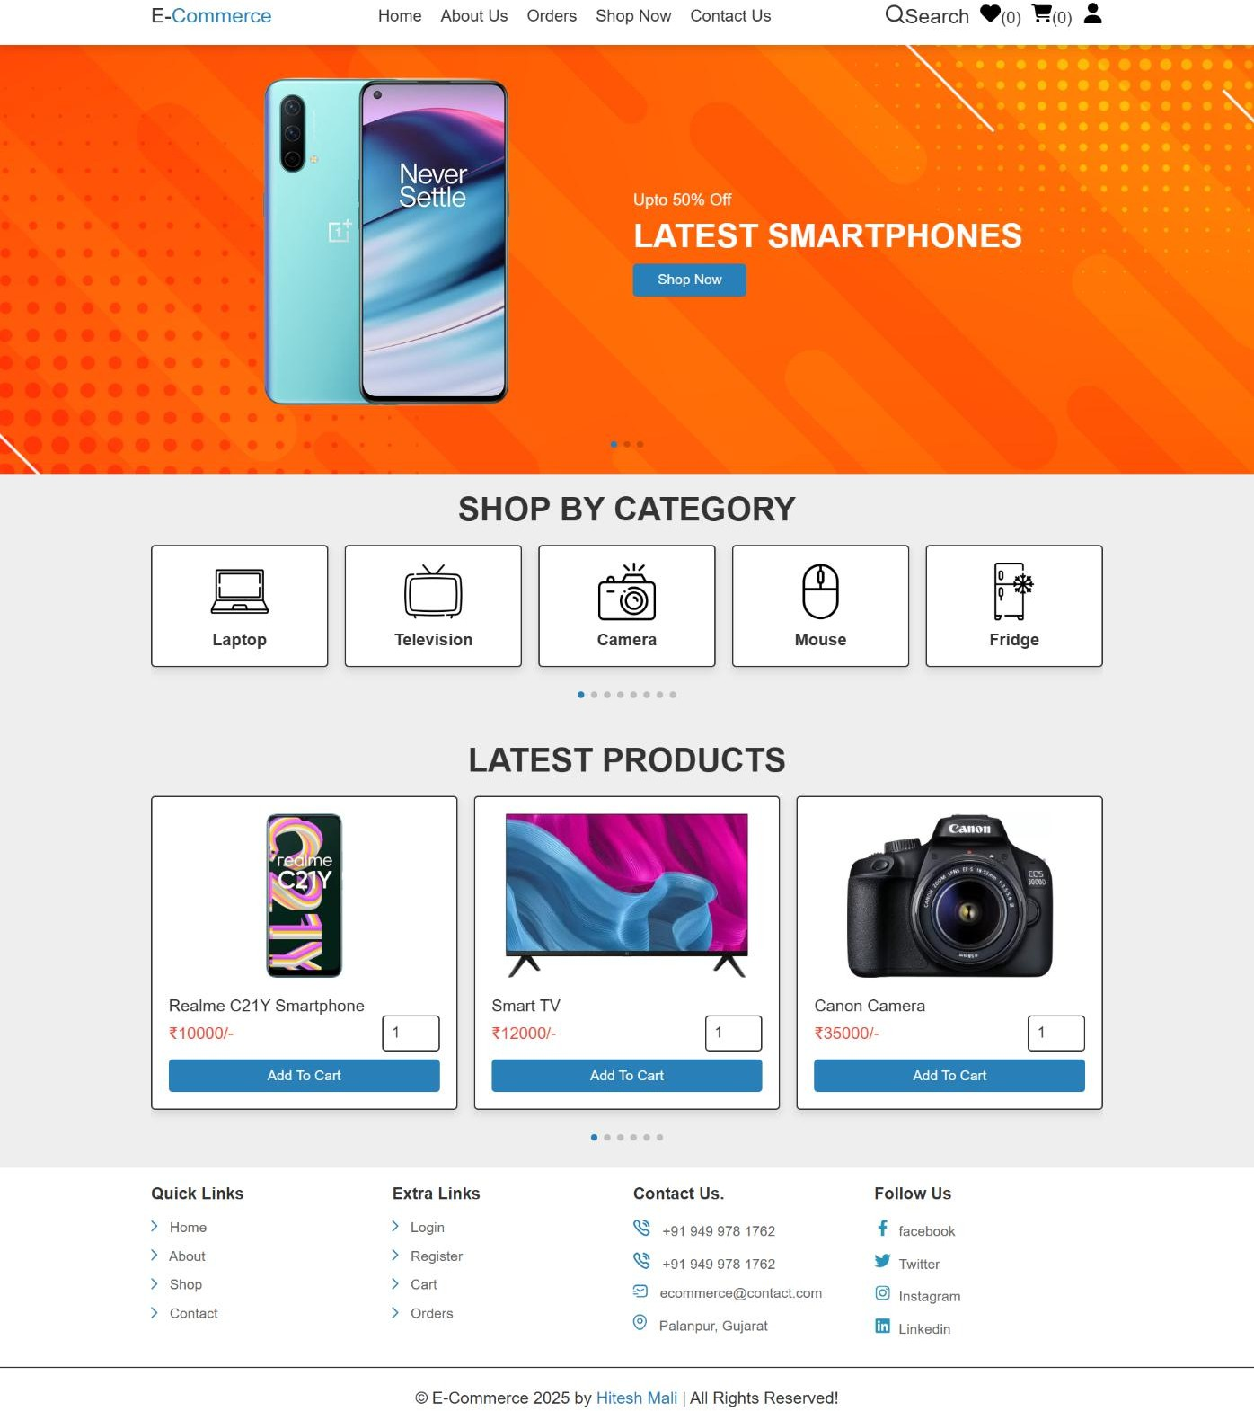
6.0 E-Commerce Website
E-COMMERCE WEBSITE
Home Page

Slide 25
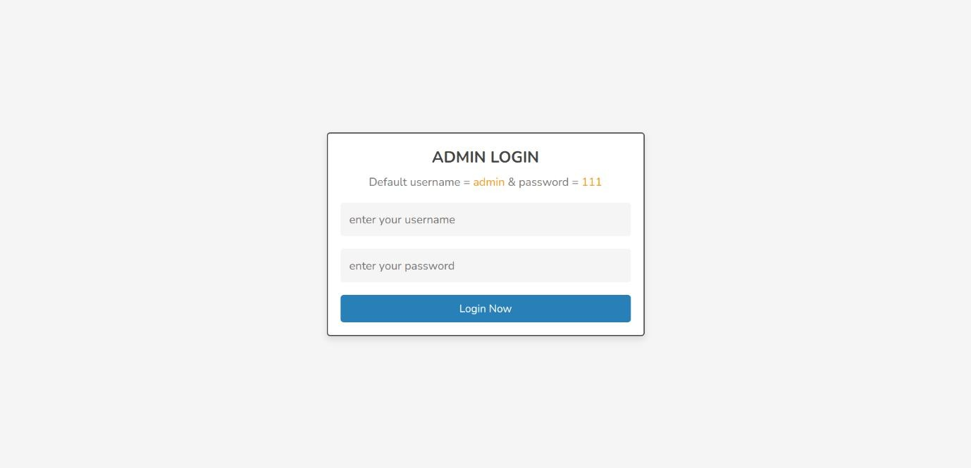
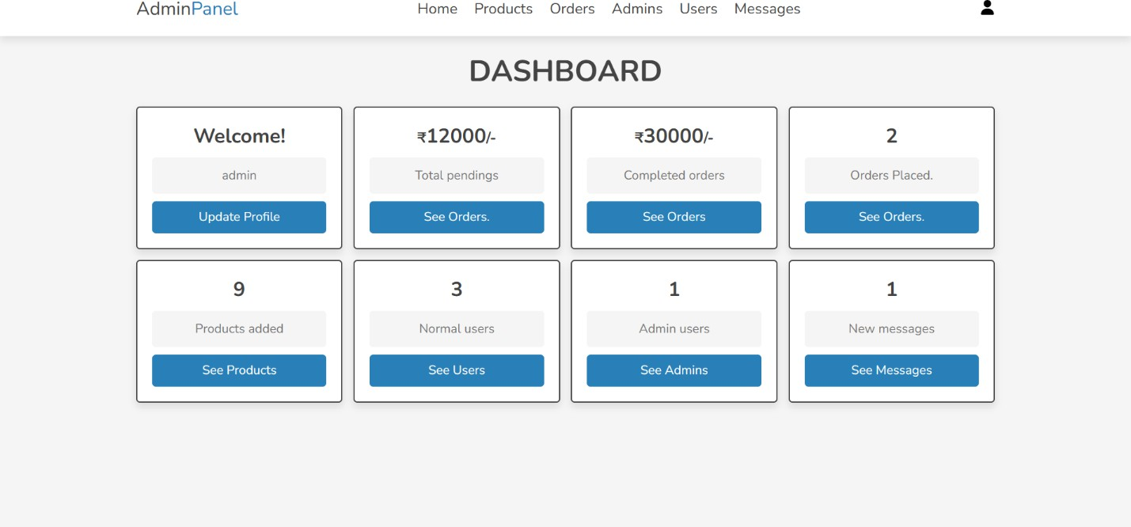
E-COMMERCE WEBSITE
Admin Login Page
Admin Dashboard Page

Slide 26
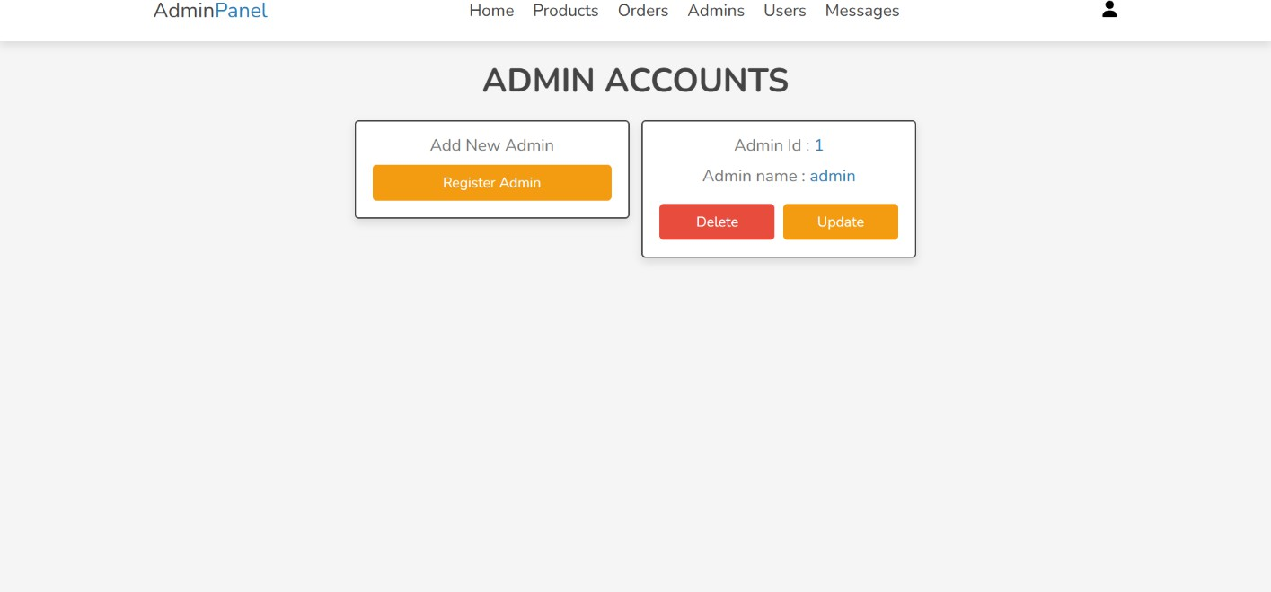
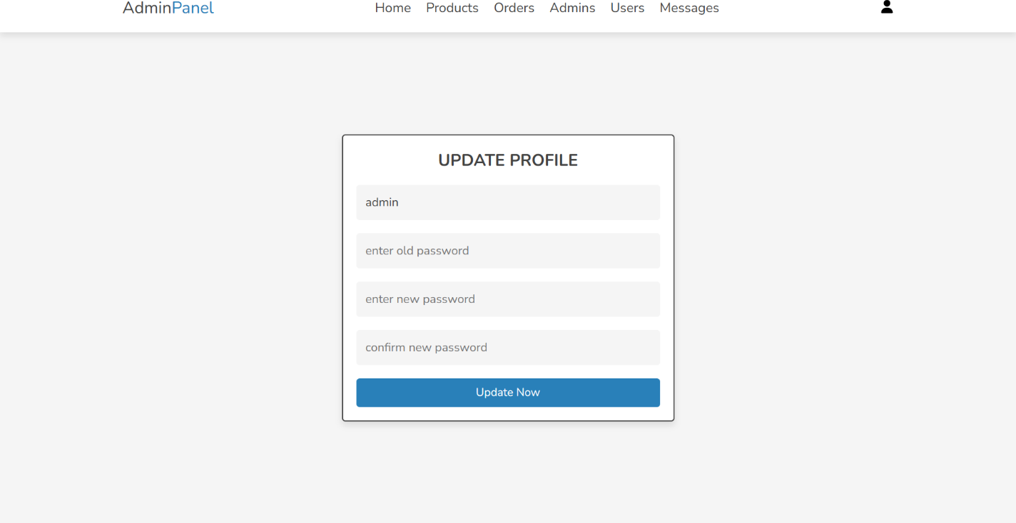
E-COMMERCE WEBSITE
Admin Accounts Page
Admin Change Password Page

Slide 27
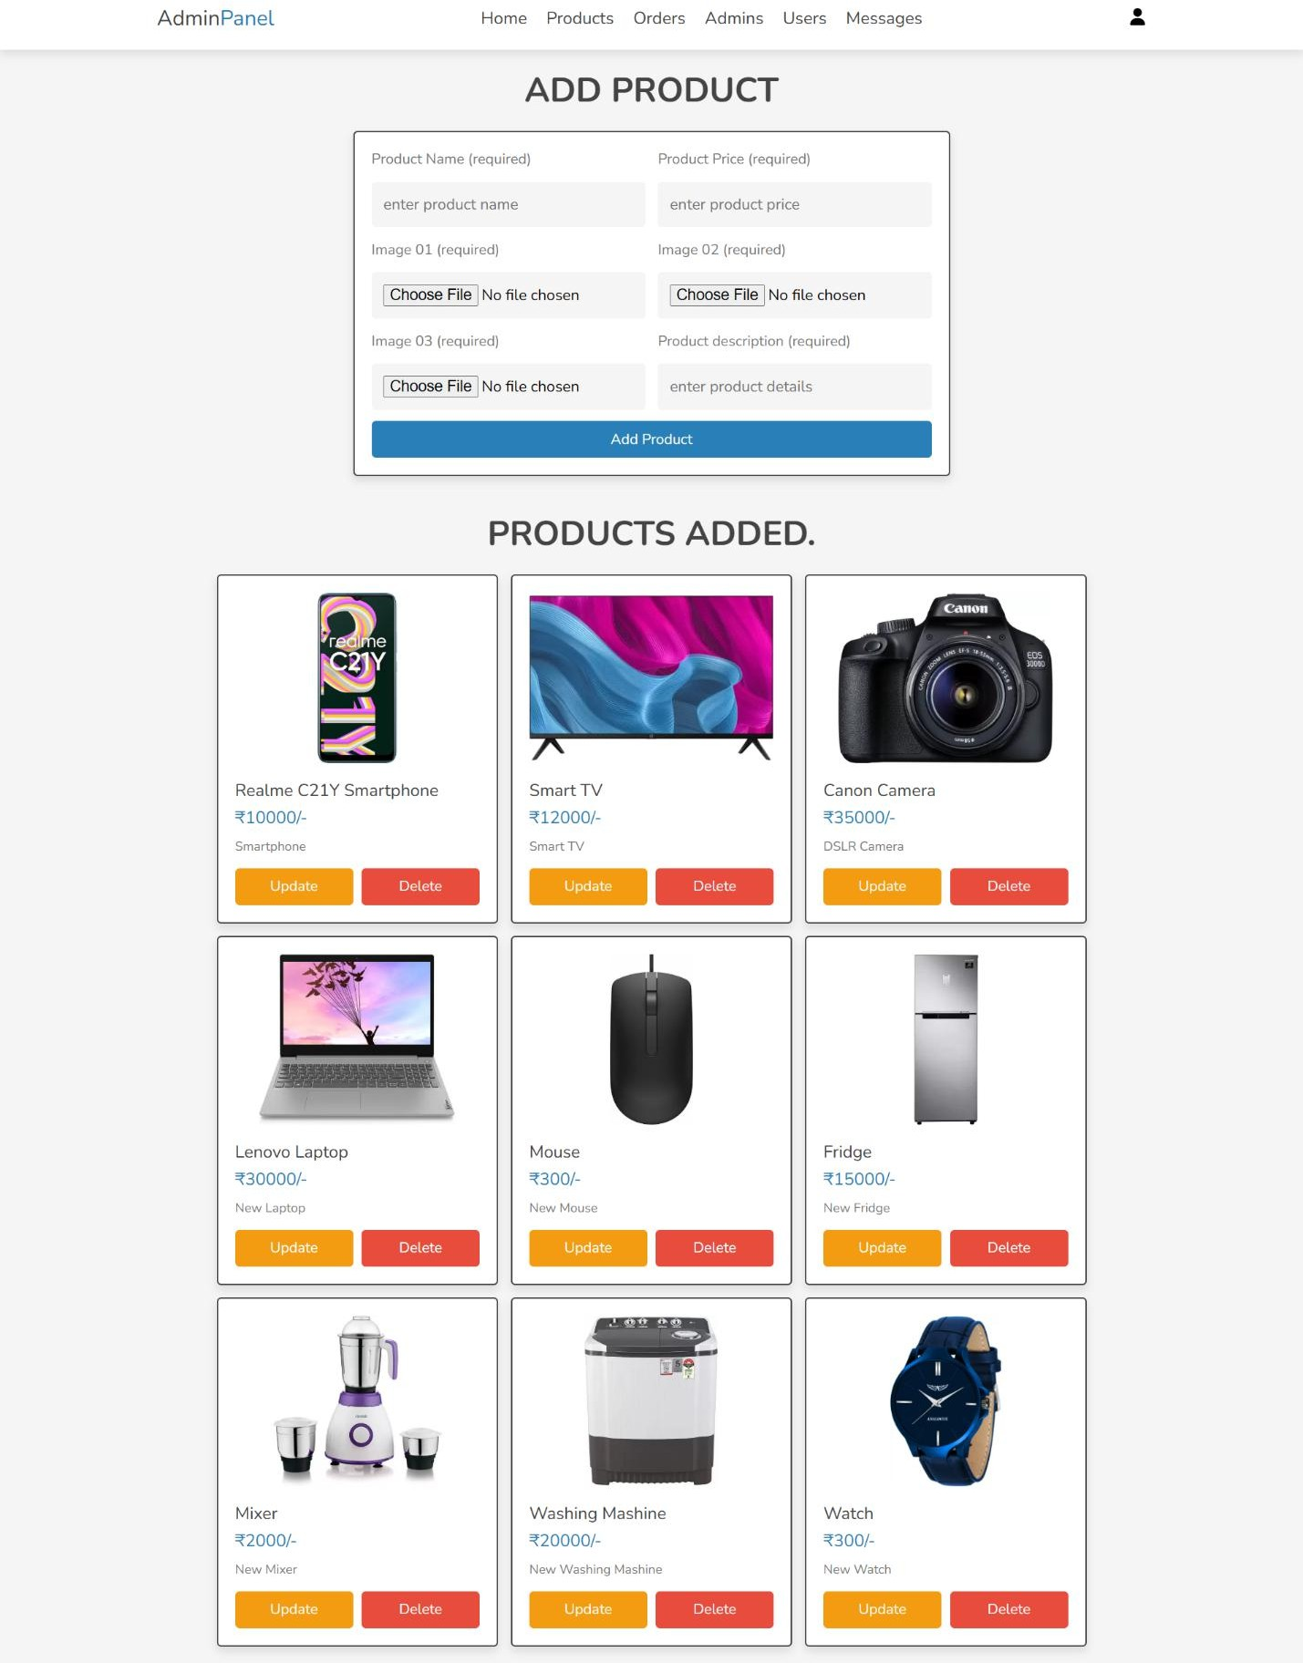
E-COMMERCE WEBSITE
Admin Product Page

Slide 28
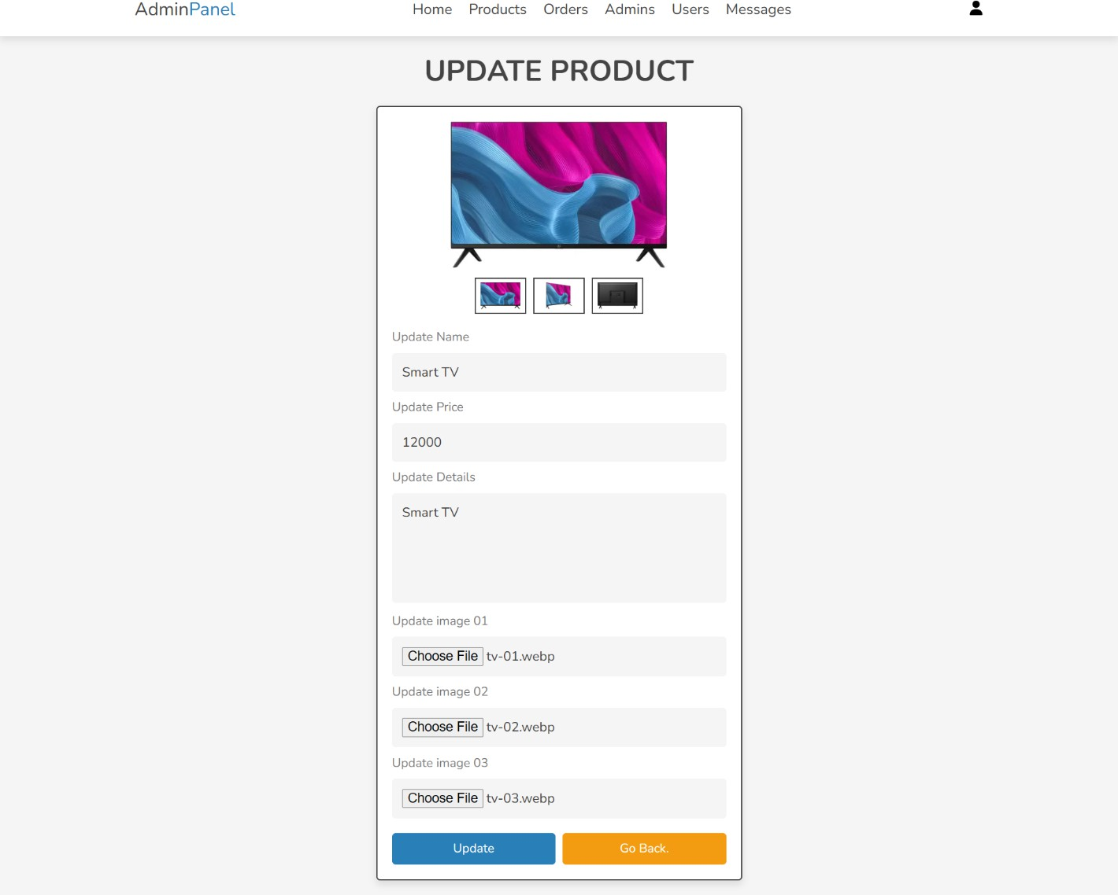
E-COMMERCE WEBSITE
Admin Update Product Page

Slide 29
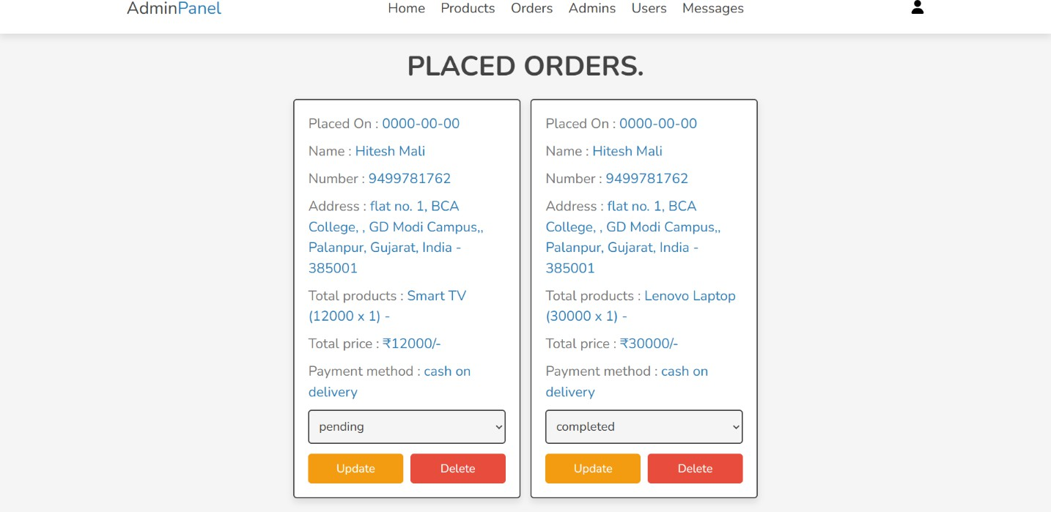
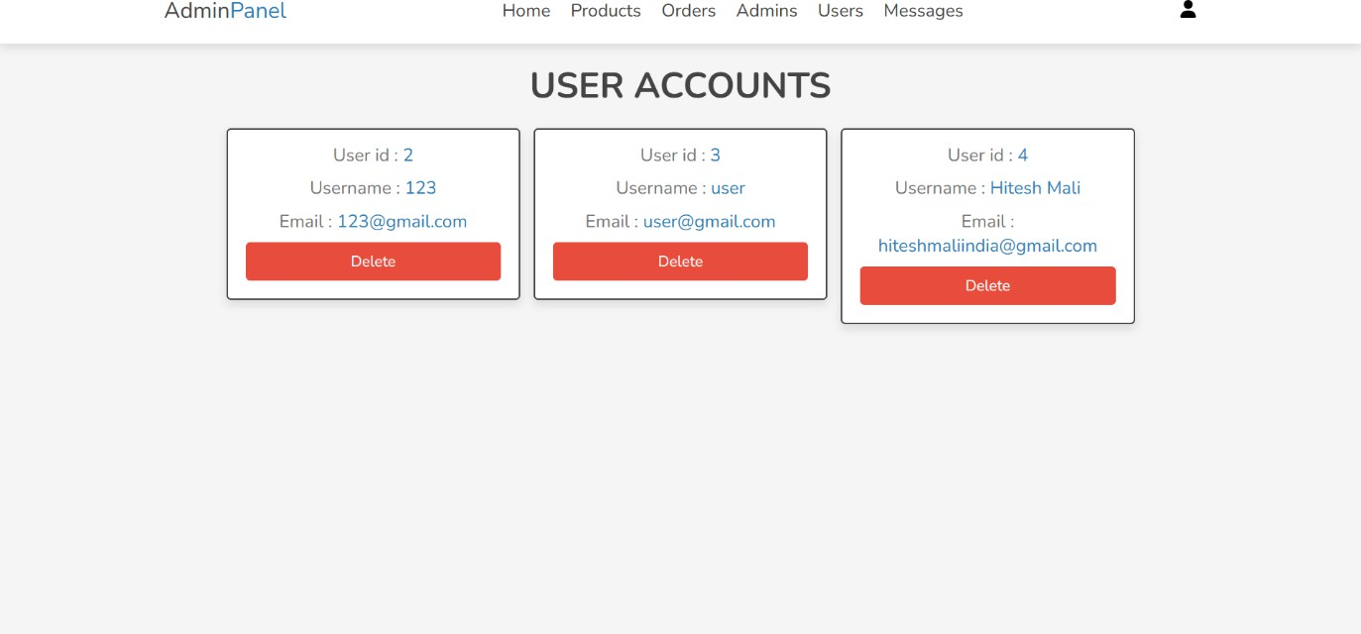
E-COMMERCE WEBSITE
Admin Orders Page
Admin Users Page

Slide 30
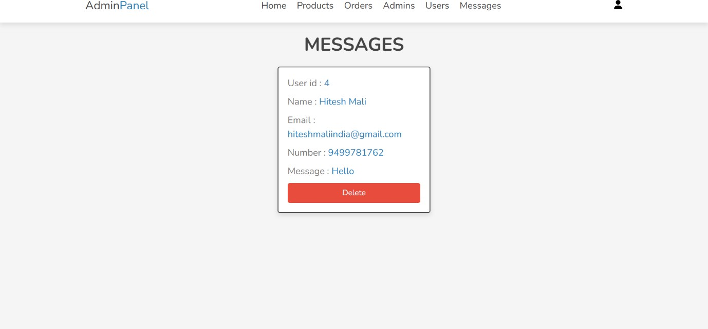
E-COMMERCE WEBSITE
Admin Messages Page
30 | P a g e

Slide 31
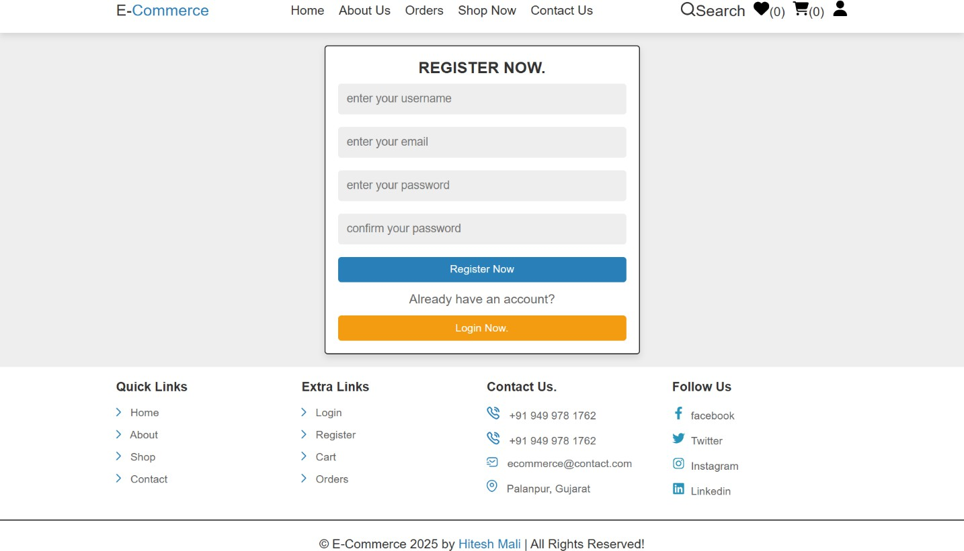
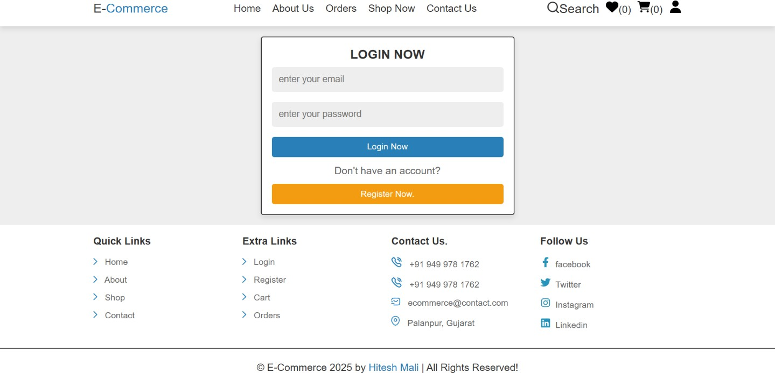
E-COMMERCE WEBSITE
User Register Page
User Login Page

Slide 32
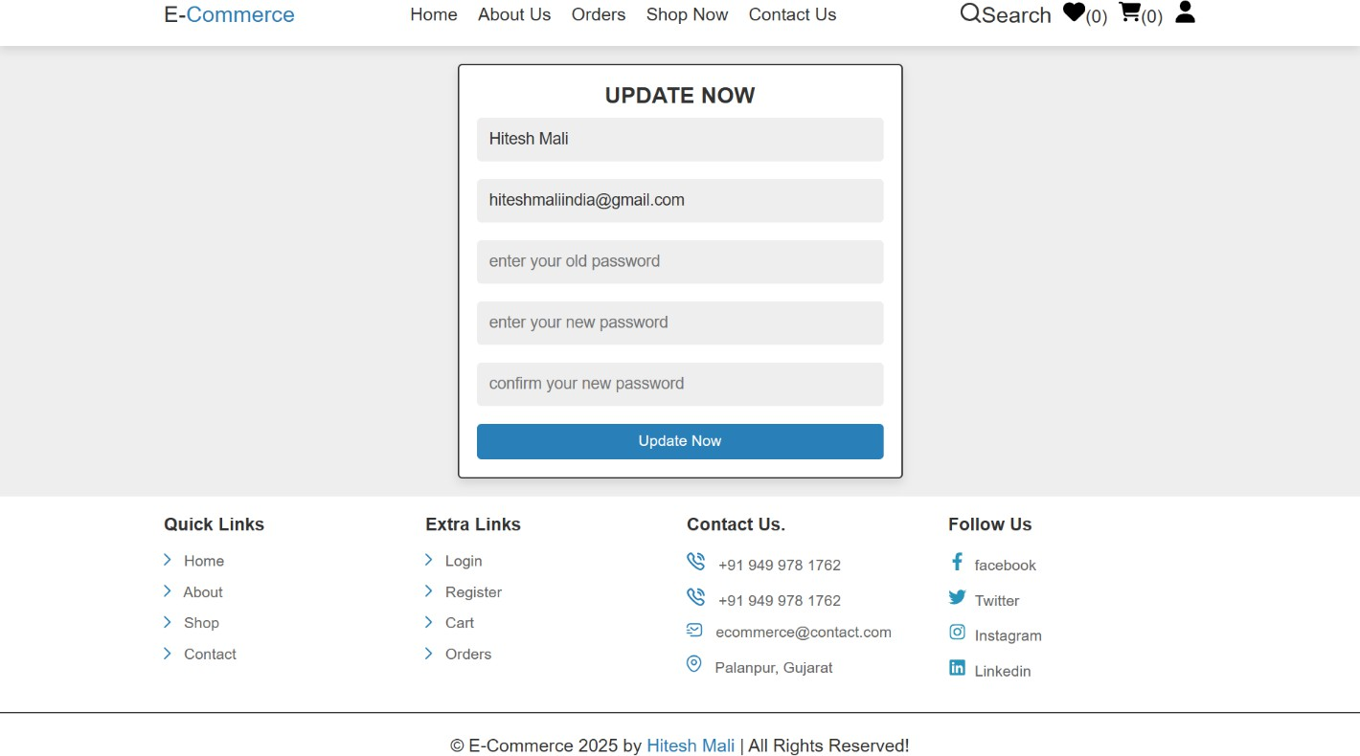
E-COMMERCE WEBSITE
User Update Profile Page

Slide 33

E-COMMERCE WEBSITE
Home Page

Slide 34

E-COMMERCE WEBSITE
About Page

Slide 35
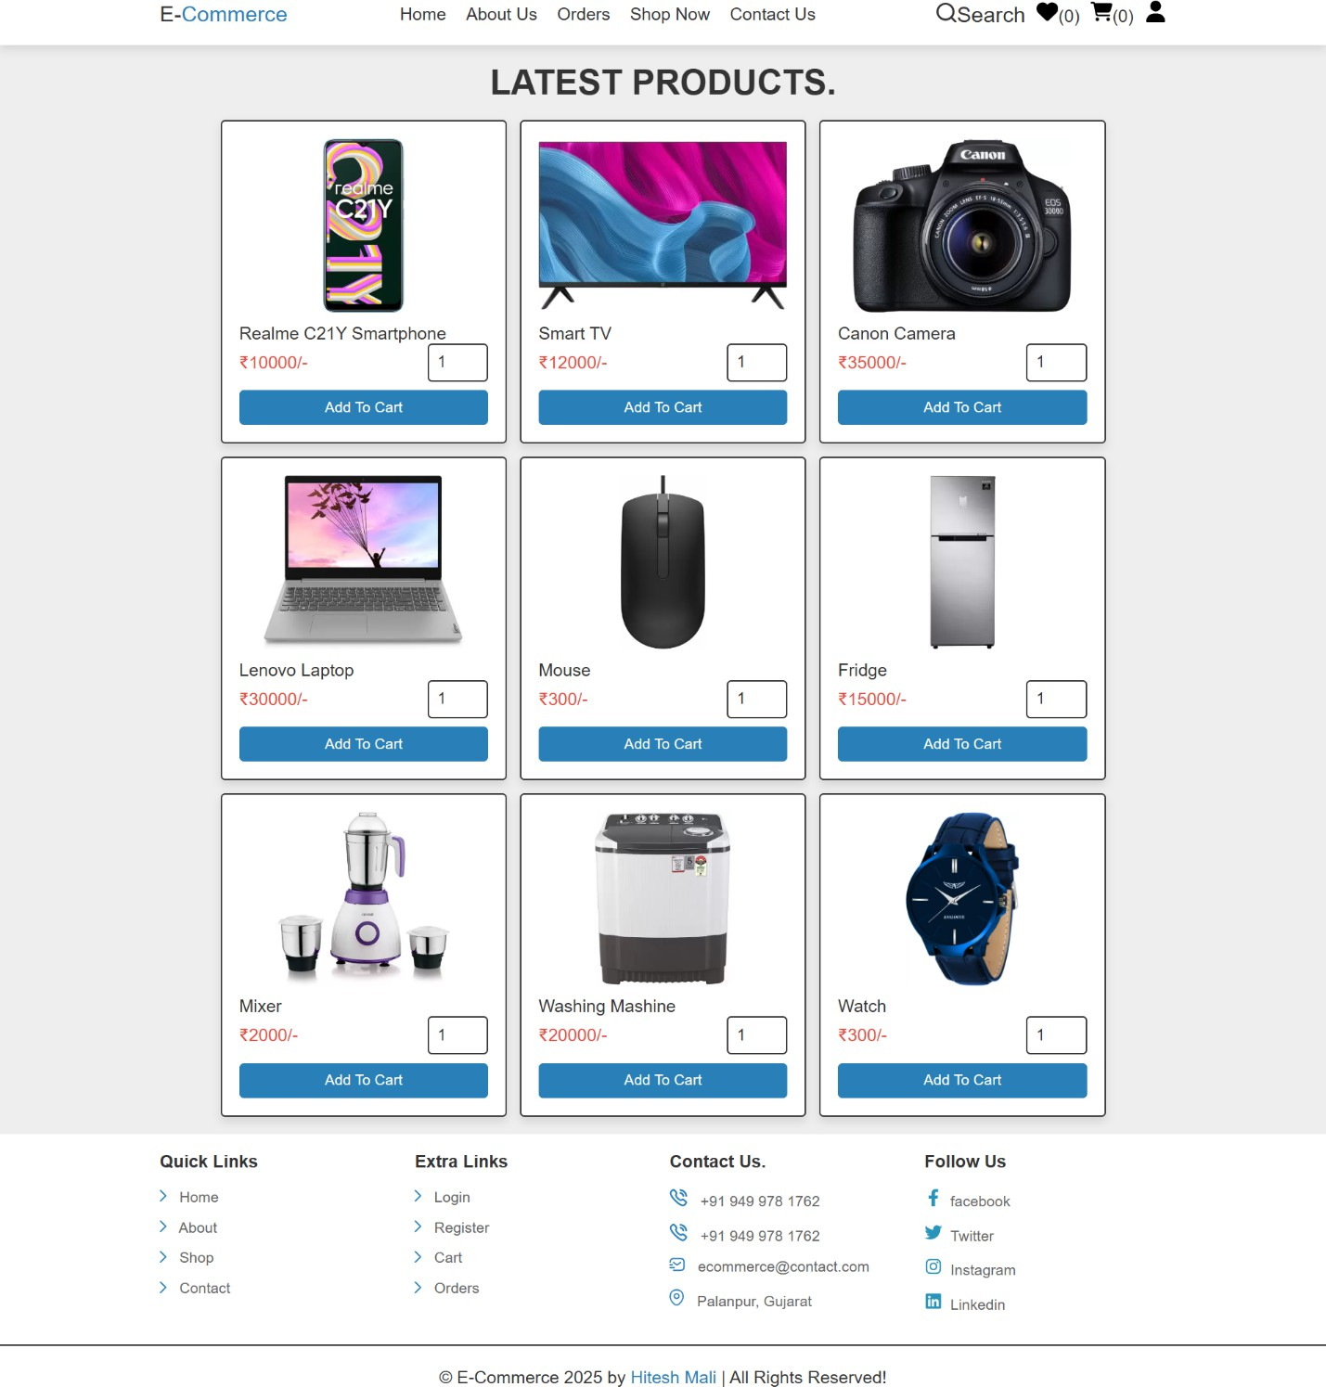
E-COMMERCE WEBSITE
Shop Page

Slide 36
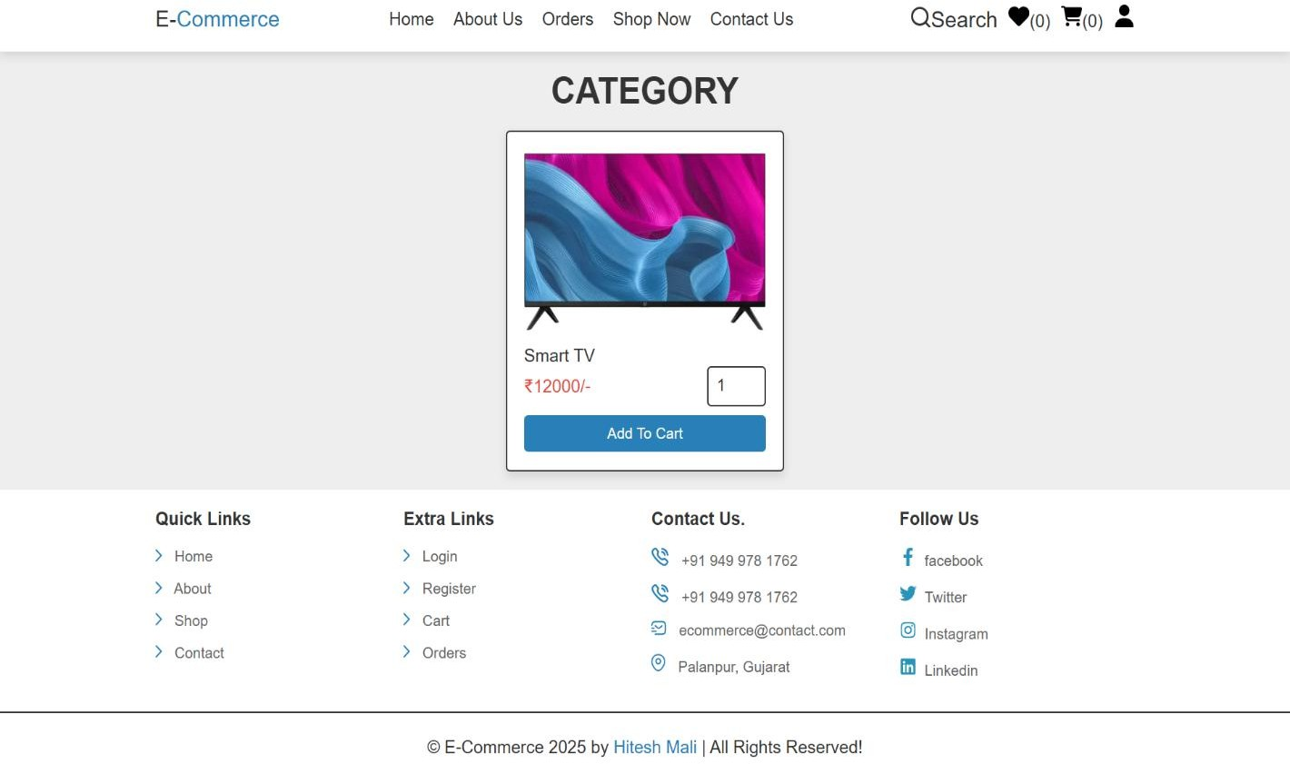
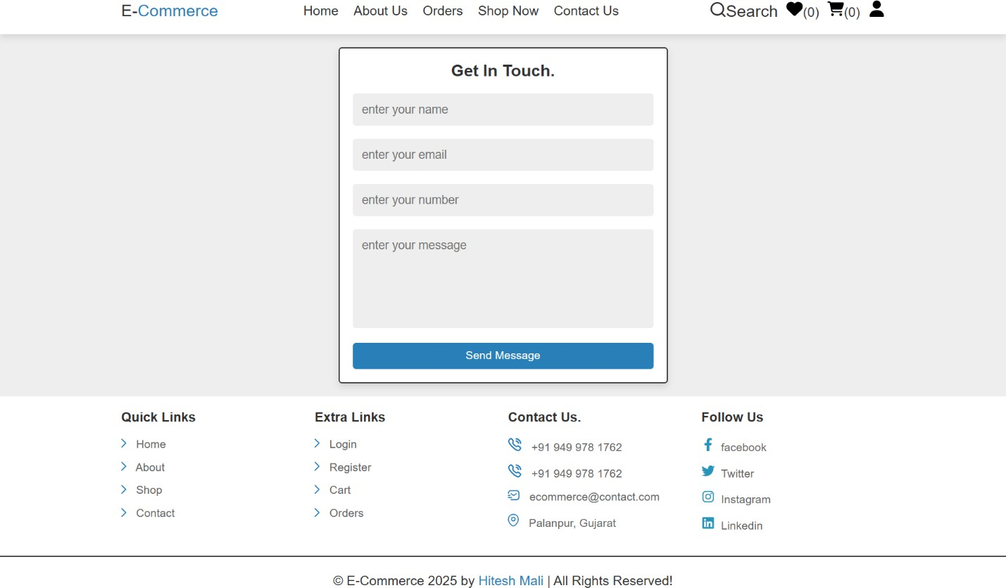
E-COMMERCE WEBSITE
Category Page
Contact Us Page

Slide 37
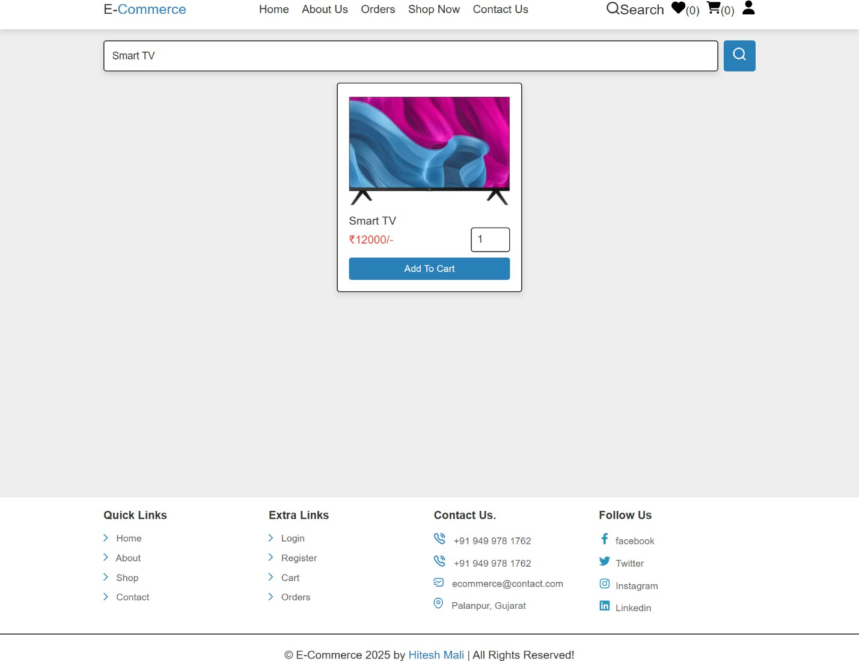
E-COMMERCE WEBSITE
Search Page

Slide 38
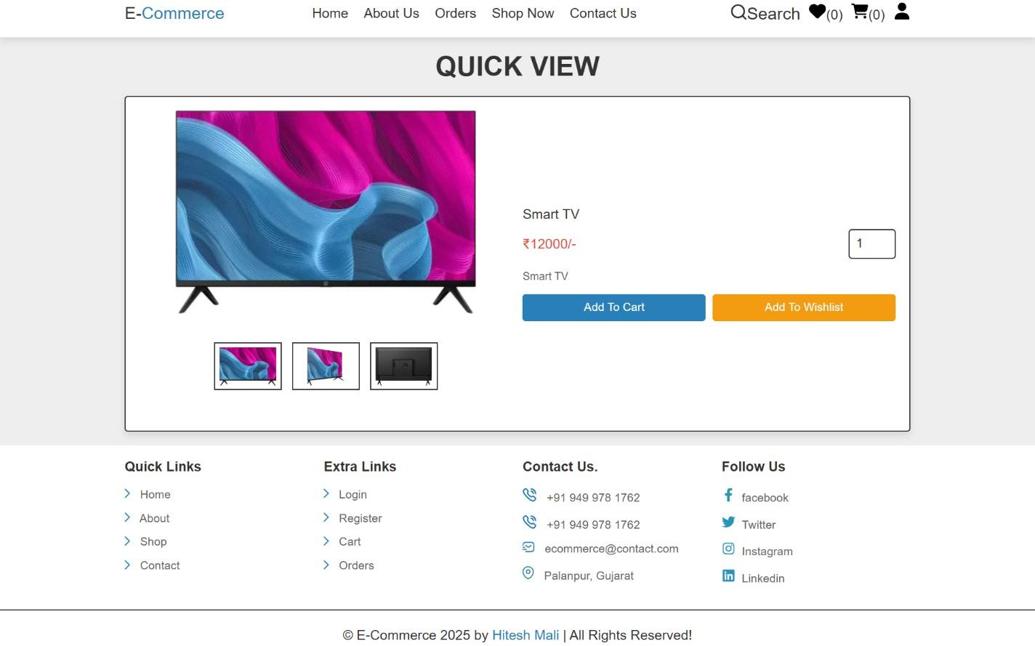
E-COMMERCE WEBSITE
Quick View Page

Slide 39
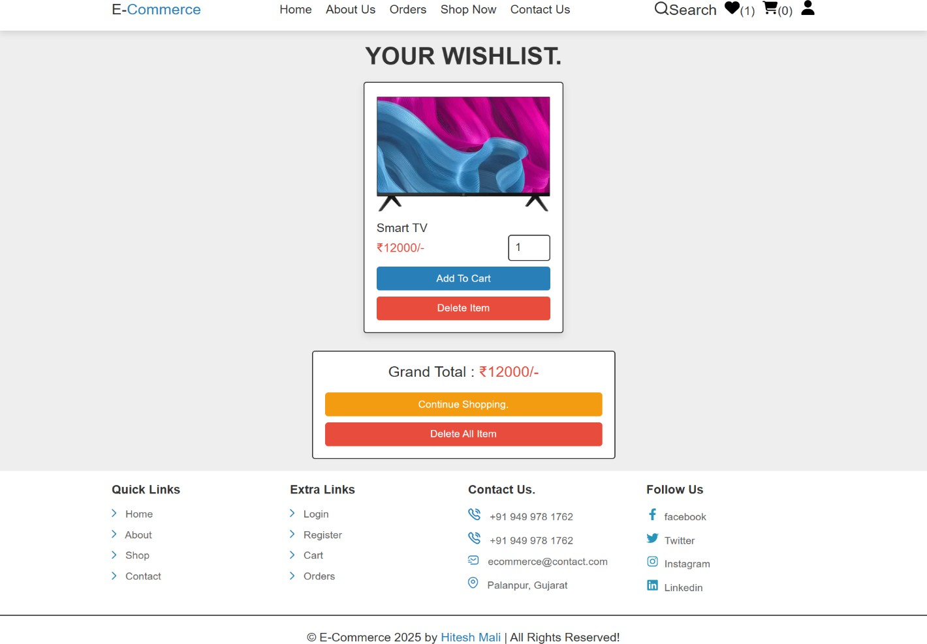
E-COMMERCE WEBSITE
Wishlist Page

Slide 40
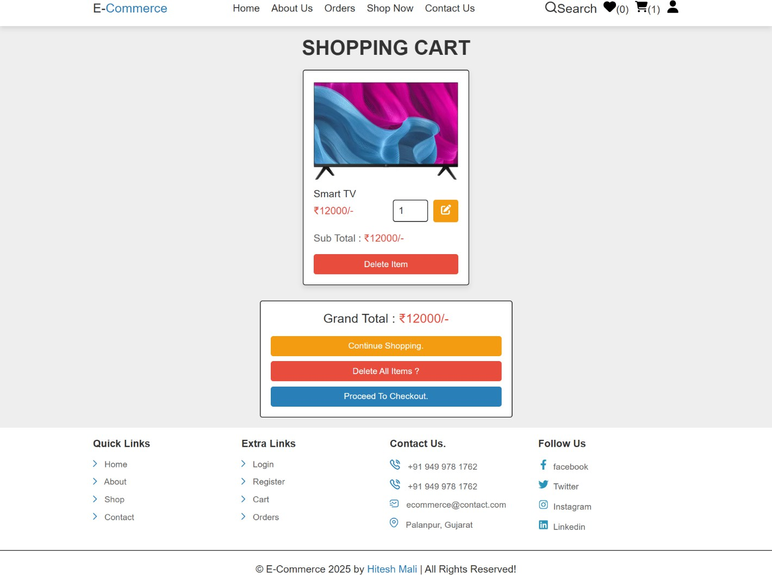
E-COMMERCE WEBSITE
Cart Page
40 | P a g e

Slide 41
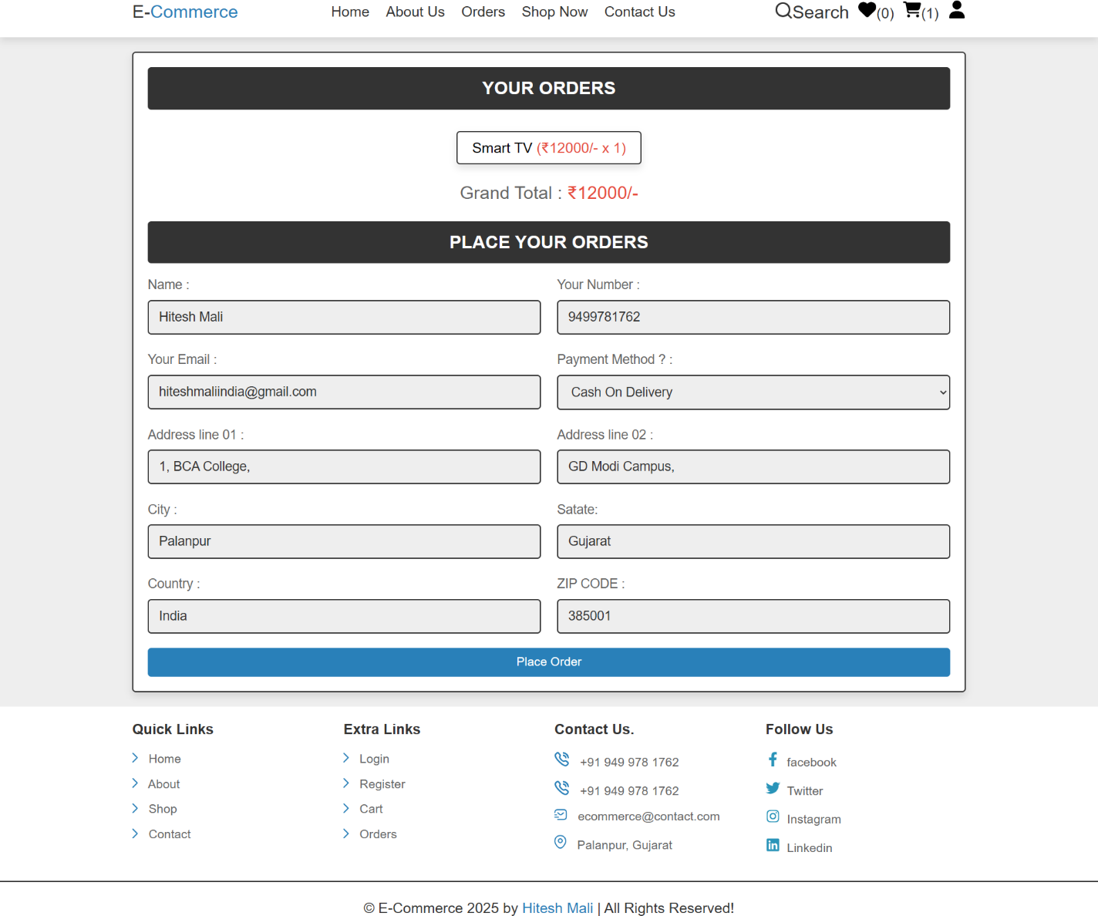
E-COMMERCE WEBSITE
Checkout Page

Slide 42
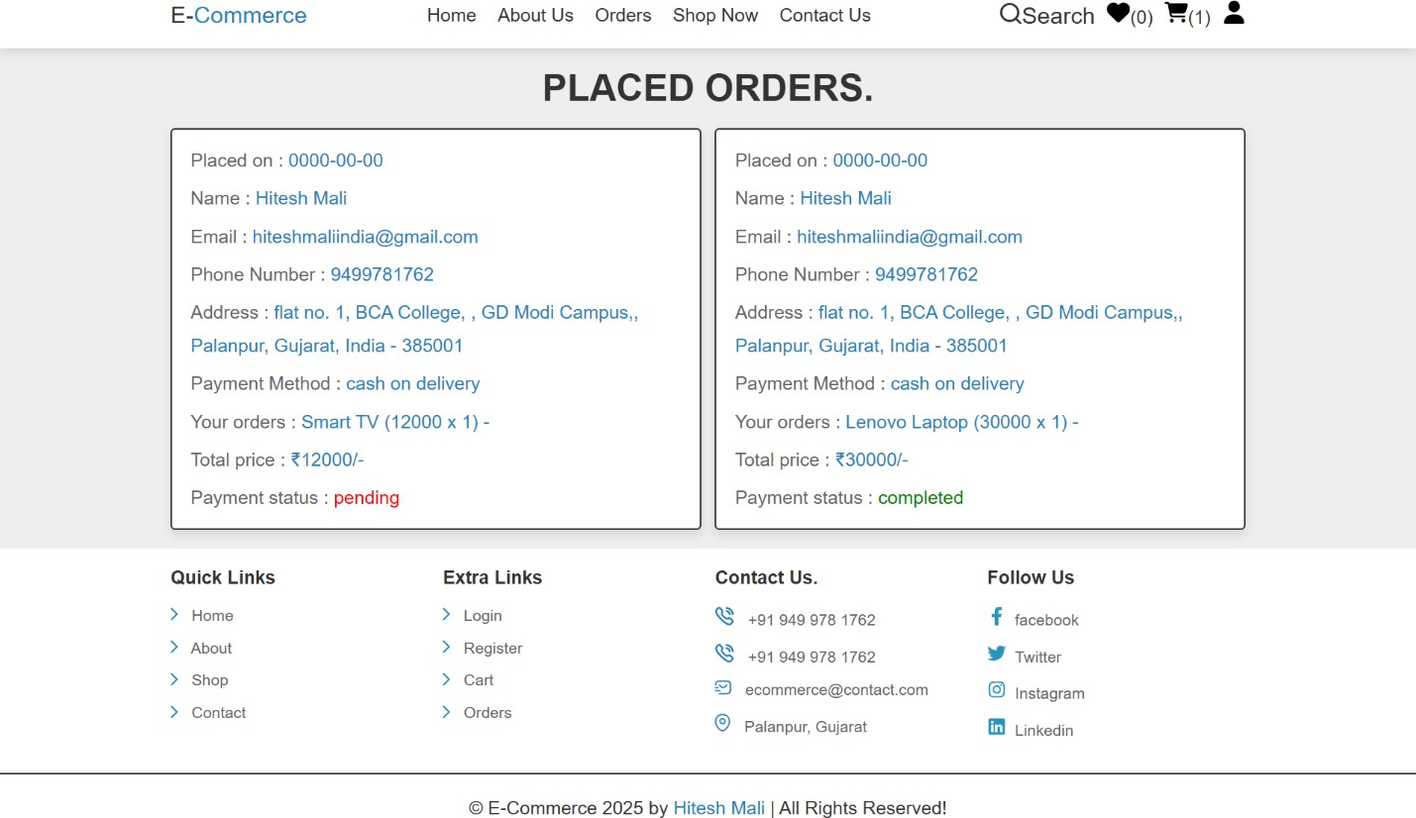
E-COMMERCE WEBSITE
Orders Page

Slide 43
7.0 References:
E-COMMERCE WEBSITE
ChatGPT
http://www.w3schools.com/
http://www.php.net/
http://www.mysql.com/
http://www.mysqltutorial.org/
The Joy PHP Programming : A Beginner’s Guide
PHP: A Beginner’s Guide
Learning PHP, MySQL, JavaScript, and CSS
PHP & MySQL Web Development

